Slide 1





Understanding and Detecting Overlay-based Android Malware at Market Scales
Yuxuan Yan, Zhenhua Li, Qi Alfred Chen, Christo Wilson
Tianyin Xu, Ennan Zhai, Yong Li, Yunhao Liu
Notes:
Thank you very much for the introduction, today I am glad to be here to make such a presentation. This is yuxuan, and I am going to talk about this paper “” which is mainly a joint work of ….

Slide 2
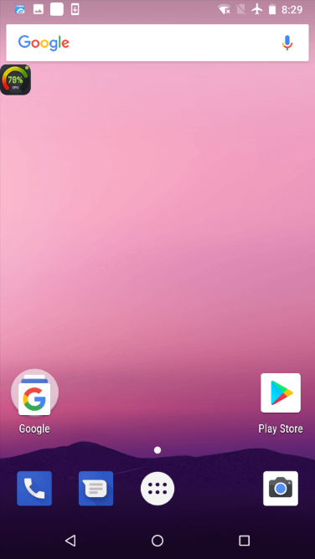
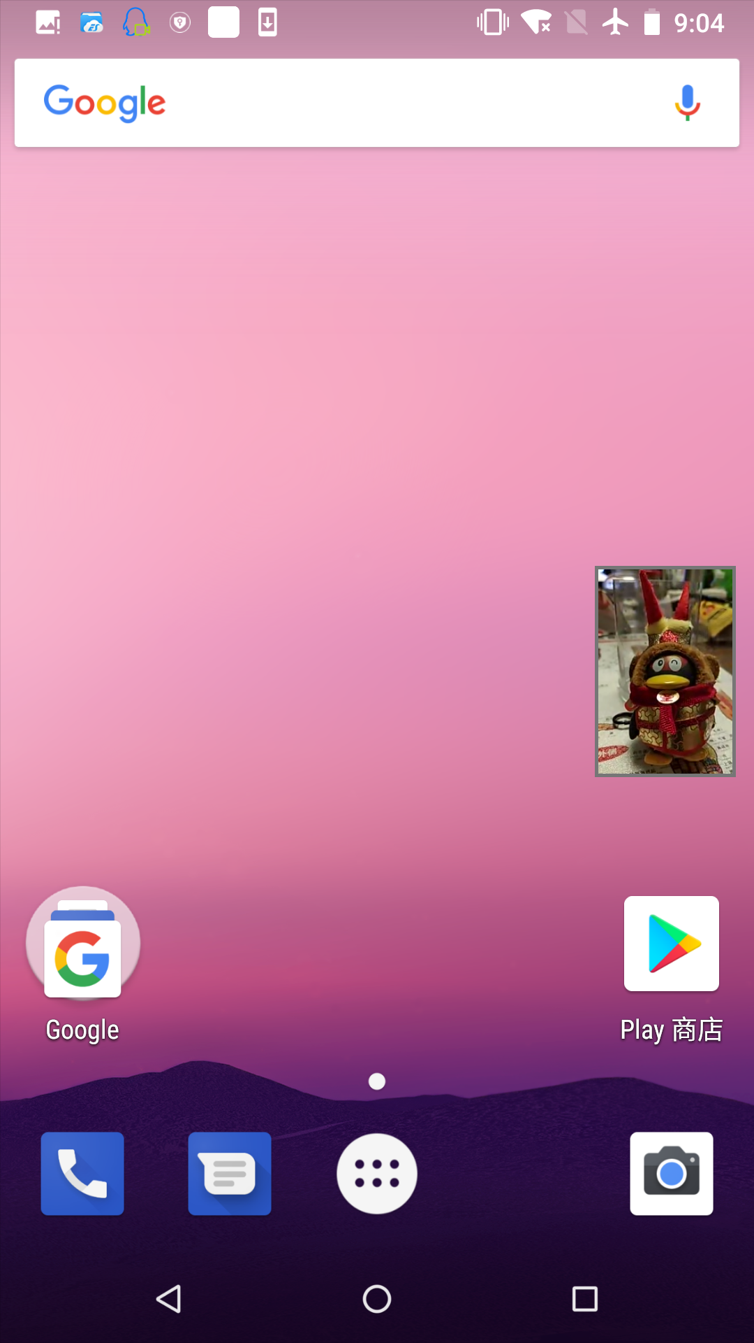
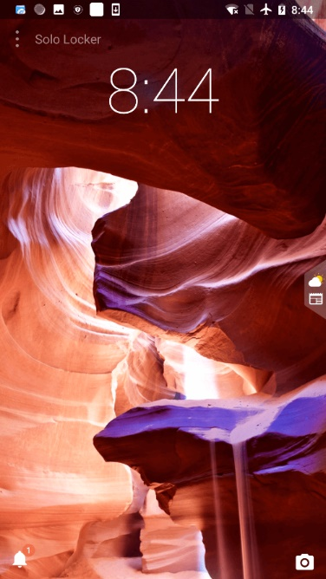
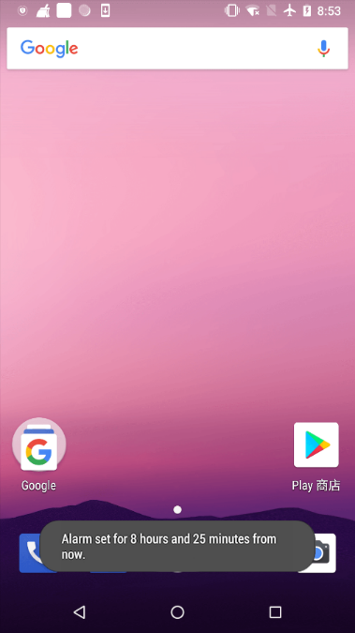
Applications of overlay on Android
(a) Show system information
(b) Voice/video call window
(c) Lock screen view
(d) System popup message
Notes:
OK, let first look at what the overlay is and what the applications of overlay are on android system. In the screen, I will present 4 typical scenes which illustrate the common usage of overlay. They are, emm, the first, such an overlay that can show system information on the top of the screen in real time, and user can interact with the “overlay icon” to get more detailed data such as cpu and memory utilization, temperature of cpu, or the upload and download rate of current network. The second, such an overlay window on the top of the screen using for voice or video call. The third one shows an overlay used for lock screen view. The last, it is a popup message window which can easily be seen in Android system. And such a kind of message windows is also implemented by overlays.

Slide 3
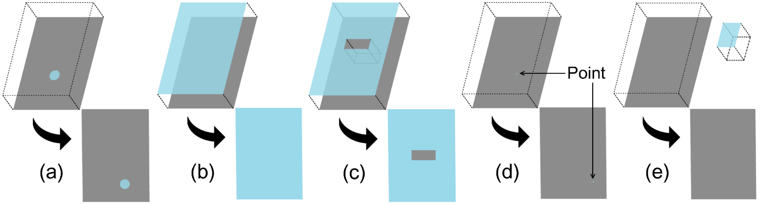
What is an overlay ?
Actually a View in Android system
An app can create one or many overlay views
Can obstruct the content of host view
Always show on the top of the screen
(a) float
(b) cover
(c) hollow out
(d) single point
(e) offscreen
Notes:
Now let us define an overlay more abstractly or you know more conceptually. Overlay is actually a view in android system. And an app can create more than one overlay at the same time. An overlay can obstruct the content of the view which under it because an overlay view is always show on top of the screen or we can say it always on top of other application windows. Here one thing that I want to remind is that all the overlays we are talking about in this paper are the system window overlays. Also, we divide them into five common forms in our study for distinguishing them easily. They are a float overlay which can be a small area floating atop the host View at an arbitrary location; a cover overlay which can be a full-screen rectangle completely covering the host View; a hollow out overlay which can be a hollow-out rectangle partially covering the host View; a single point overlay which is rather difficult to notice; and an offscreen overlay which can not be notice by users. For example, an overlay used for video call which we showed on the last page is a kind of float overlay. Different from ios, overlay in android can be created across the apps rather than within the same app. This facilitate a user’s interactions with multiple apps, but also bring the danger at the same time.

Slide 4

Overlay-based attacks
(a) float
(b) cover
(c) hollow out
(d) single point
(e) offscreen
(a) malicious redressing attack
(b) GUI hijacking attacks based on transparent overlays
(c) misleading users over the meaning of interaction
(d) (e) capture sensitive inputs or UI events
Notes:
According to those specific forms of the overlay. There are corresponding attacks leveraged by them. For example, the float overlays can be used for malicious redressing attack. And the cover overlays can be used for GUI hijacking attacks which are based on transparent views. The hollow-out overlays can be used for misleading users over the meaning of the interaction by manipulating the covered overlay. And single point overlays as well as offscreen overlays can be used for capture sensitive inputs or UI events on Android system.

Slide 5
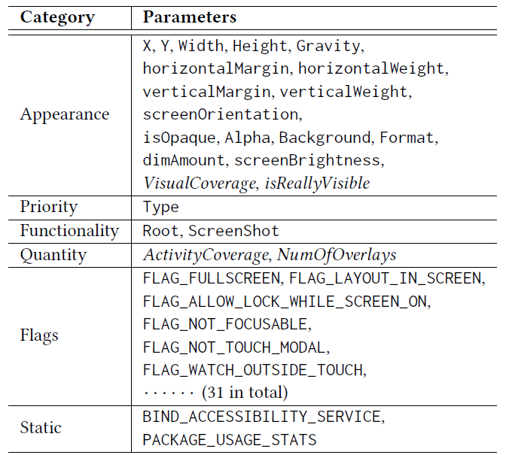
Features of an overlay
Most features are dynamic features, which only exist when an app is executed on user devices
Notes:
Here comes to the issue. How can we detect malicious overlays among those complicated scenes. Are there any characteristics that those different forms of overlays have? So we did an app emulation experiment to find out the truth. First, we find all the corresponding features through official android api documents. Those features are including the category of appearance, for example x, y, width, height of the overlay, etc; the categories of priority, functionality and flags which can determine overlays capability. And two static features which can amplify the capability of overlays. Among those features, there are four novel features designed for the app emulation experiment specially.

Slide 6

Dataset collection
Tencent Market has identified and labeled over 2.4M malicious apps and over 6M benign apps since May 2015 with their malice and category labels.
Trigger API to output log
Tencent Market
https://sj.qq.com/
Notes:
Second, let me introduce where our dataset come from. Our dataset is all from the T-market. T-market has identified and labeled over 2.4millions malicious apps and over 6millions benign apps since May 2015 with their malice and category labels. We sampled a part of apks from this big database, as well as a modified AOSP system where we added log codes of the overlay information to do the app emulation. This entire analysis work were completed using several commodity servers. During the app emulation, we explored app by Monkey UI exerciser. Money is a kind of tool that can generate UI event streams at both application and system levels. Whenever Monkey hits an overlay object, it records corresponding features which we have mentioned before for later analysis. Those features can be extract from the overlay log after the app emulation process.

Slide 7
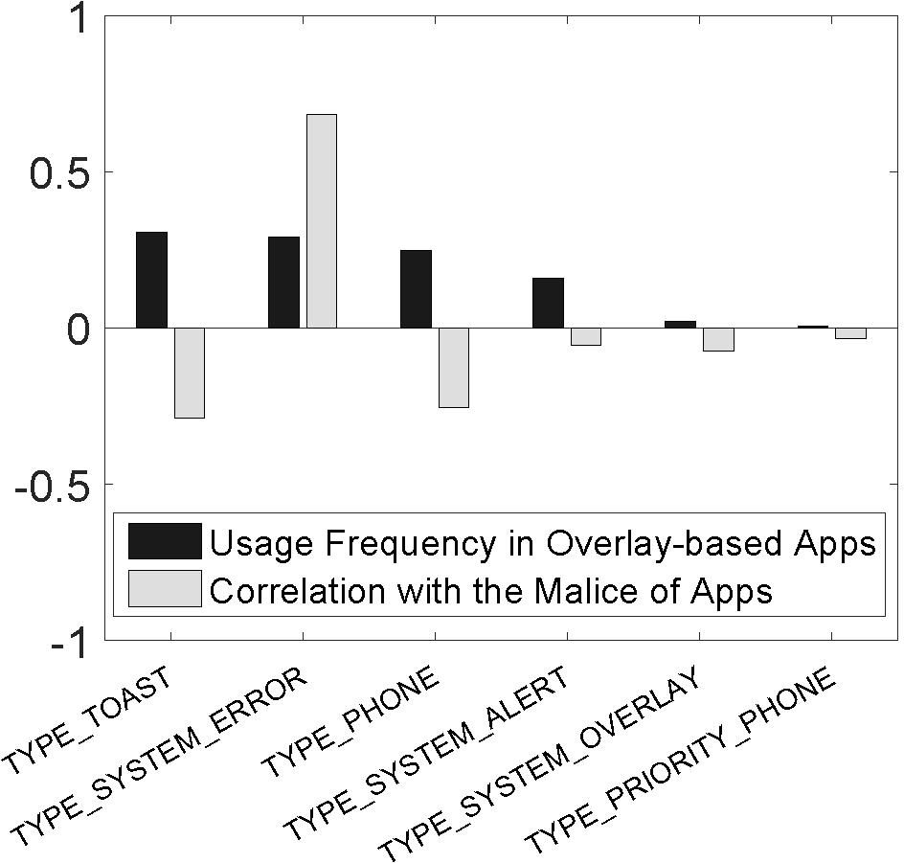
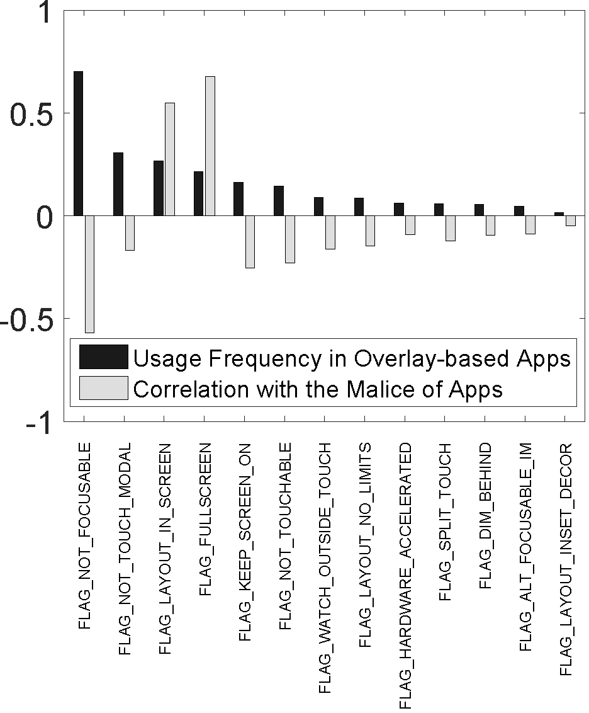
Type & Flag
Type
Flag
Notes:
Then, based on this experiment, I would like to introduce some of the interesting study result. We use pearson correlation coefficient to describe the relation between malic and the features. Also, we draw some figures to illustrate them more directly. For feature type, we find that six Types listed in Figure are the most frequently used. 84% of the apps that use TYPE_SYSTEM_ERROR overlays are malicious, and the PCC between TYPE_SYSTEM_ERROR and the malice of apps is as high as 0.69. This is because TYPE_SYSTEM_ERROR possesses the highest priority among all the Types. You know, a TYPE_SYSTEM_ERROR overlay can even appear on top of the lock screen interface. For feature Flag, We study all the 31 Flags of Android overlays. This figure depicts the statistics of the 13 most frequently used Flags. We observe that the top four Flags’ correlations with the malice of apps differ greatly. For example, 82% of the apps that use FLAG_FULLSCREEN overlays are malicious and the PCC is as high as 0.68. This is mainly because a FLAG_FULLSCREEN overlay can cover the whole screen, you know including the status bar and thus can easily deceive mobile users.

Slide 8
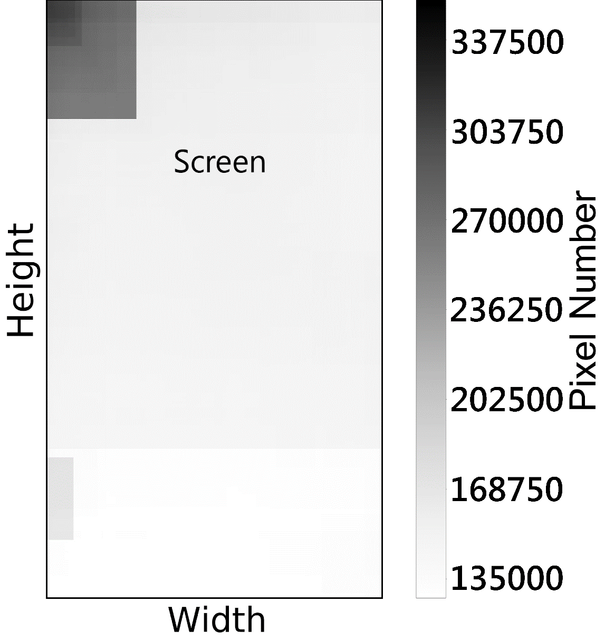
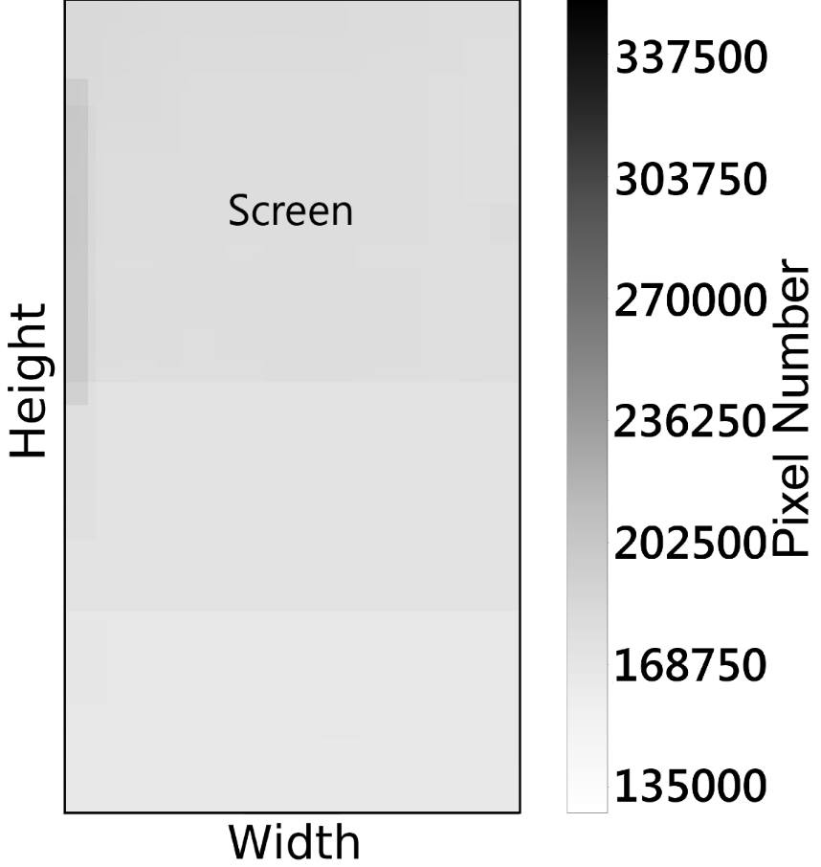
Visual coverage scope
Benign apps
Malicious apps
Notes:
We also plot the heat maps of the Visual Coverage scopes for benign and malicious apps’ overlays The frame of each figure represents the screen of common Android smartphones. Again, we notice distinct distributions between the overlays’ Visual Coverage scopes of malicious and benign apps. Specifically, we observe that for benign apps’ overlays, the Visual Coverage scopes tend to locate at the top left corner of the screen. For example, some of the overlay prefer to show system status information at that place.
But for malicious apps’ overlays, the Visual Coverage scopes do not have a preferred region in the screen. This indicates that an overlay’s Y coordinate and Gravity are also correlated with the malice of its affiliated app.
For analysis of other features in detail, please refer to our paper.

Slide 9
OverlayChecker: basic principle
Step 1: Overlay feature extraction
Step 2: Overlay/app classification
Step 3: Assisting app review
Notes:
Next, I would like to show you how we design and implement the overlaychecker. First, we use machine learning way to train our overlay feature which we have extracted from the app emulation stage. Second, we embed the machine learning model into the market and become overalychecker. Then OverlayChecker takes an app’s APK file as input and outputs the estimated malice of every detected overlay in the app.

Slide 10
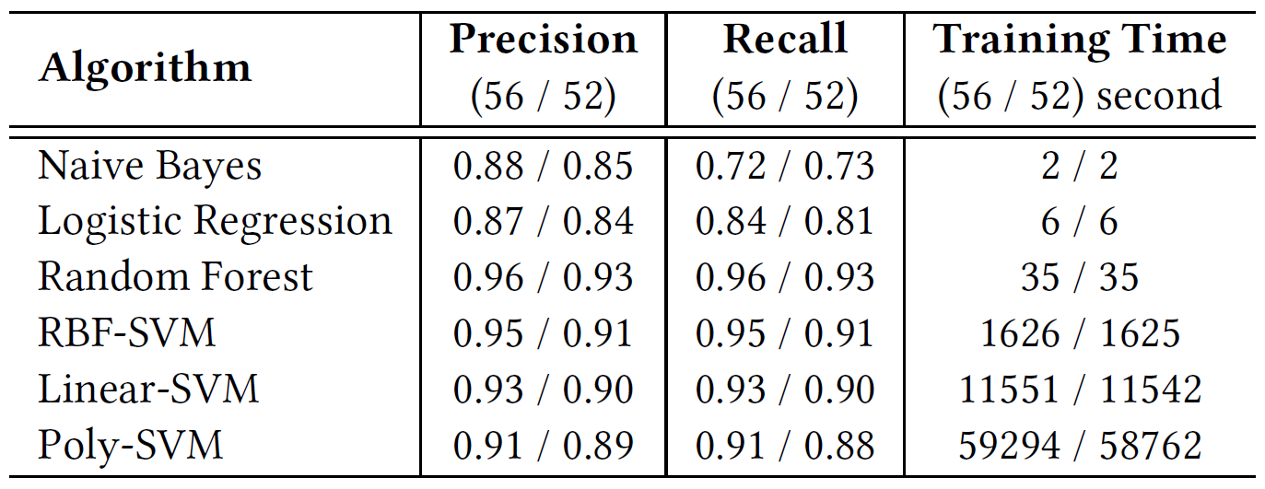
Classification model
Efficacy of different classification algorithms using 56 overlay features vs. the 52 original overlay features
Our defined four novel features improve the accuracy by ∼3%
Notes:
Here I want to introduce you some evaluation parts of our study. Before we choose random forest model as our final detecting model. We compare random forest model with several other algorithms such as naïve bayes, lr, svm all together. From the perspective of efficacy and performance we choose random forest model at last. And It's worth mentioning that our proposed four novel features improve the detection accuracy of malicious overlays by ∼3% regardless of classifier. Note that such 3% increase is not trivial when the precision/recall is already very high.

Slide 11
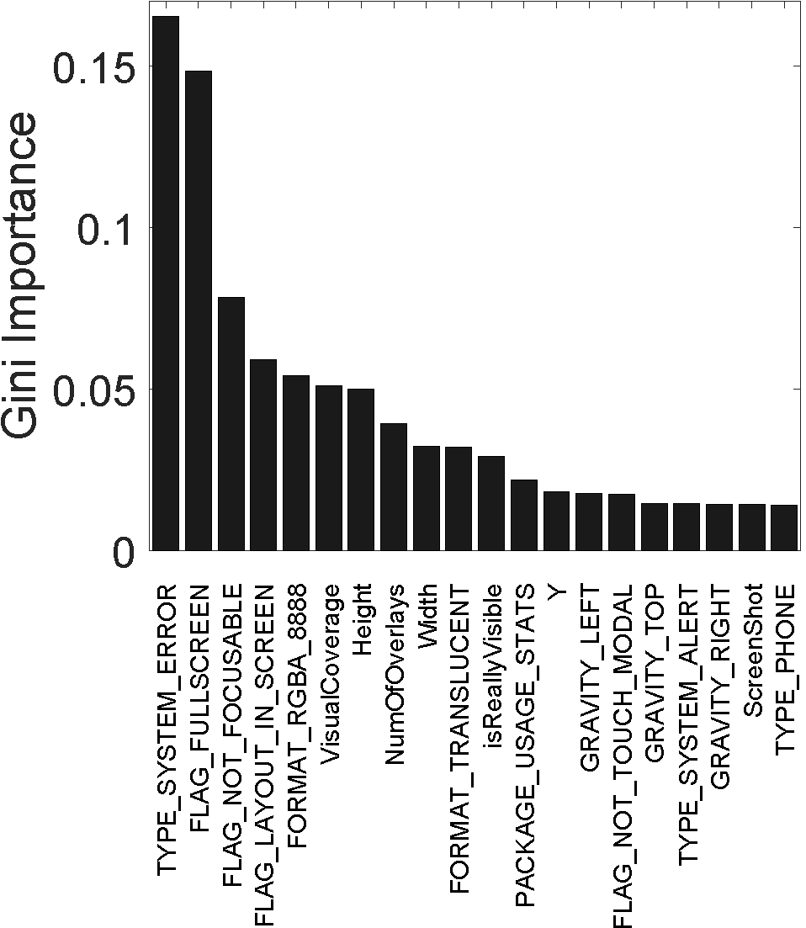
Feature importance ranking
The most importance features are TYPE_SYSTEM_ERROR, FLAG_FULLSCREEN, FLAG_NOT_FOCUSABLE
Our introduced novel features VisualCoverage, NumOfOverlays and isReallyVisible rank the 6th, 8th and 11th
Notes:
We also use Gini importance to profile the correlations between the overlay features and the malice of apps. Gini importance is the inherent criterion that is used in random forest model. And the results are consistent with our measurement findings in Overlay behavior study.
For example, TYPE_SYSTEM_ERROR’s highest importance complies with its highest correlation with the malice of apps.
And our introduced novel features VisualCoverage, NumOfOverlays and isReallyVisible rank the 6th, 8th and 11th in Gini importance and it also illustrates their contribution in classification of malic.

Slide 12
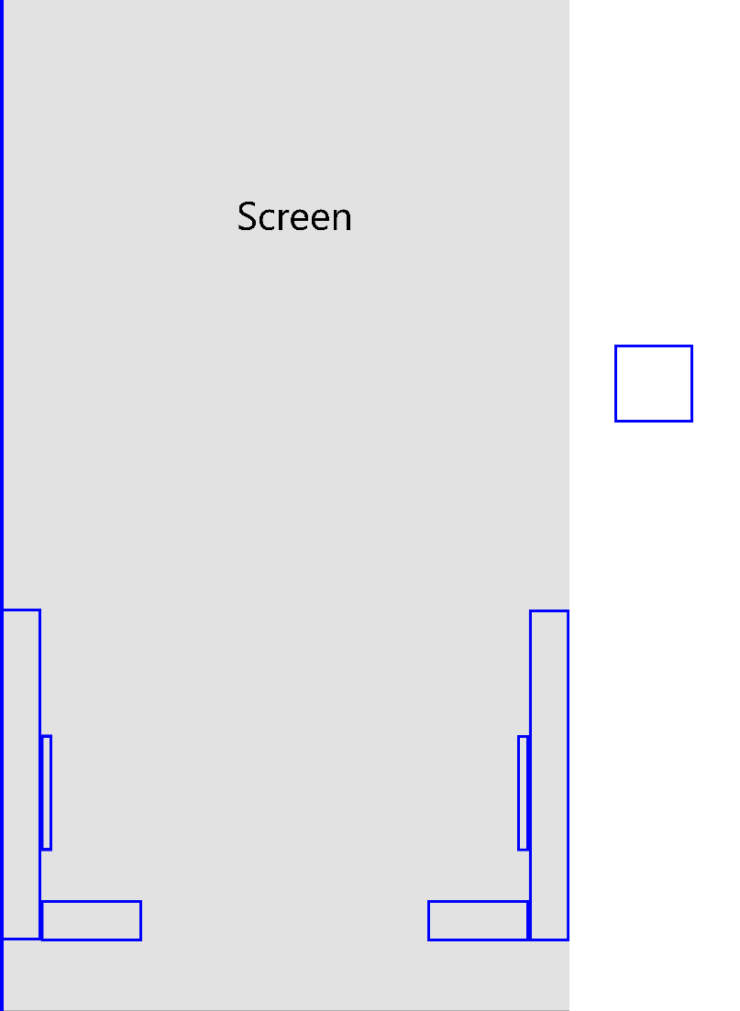
Extensibility to Google Play
OverlayChecker is still able to detect 0.2% apps (among 10k apps) with malicious overlay behavior
We manually checked each suspicious app to examine and found there are indeed some malicious overlay behaviors
Notes:
For Extensibility, we extend our OverlayCheck to Google play store. We applied it to 10 K randomly sampled apps released on Google. Despite Google’s own sophisticated security checking, OverlayChecker is still able to detect 20 (0.2%) apps with malicious overlay behavior. We manually checked each suspicious app to examine and found there are indeed some malicious overlay behaviors. For example, in the figure on left side of the screen. We show all the overlay that an app called “Du-Anti-virus” used. These multiple overlays are all in weird shapes and locations. And these weird overlays are dangerous enough to be leveraged to do some malicious behavior. So this app is flagged by our system.

Slide 13
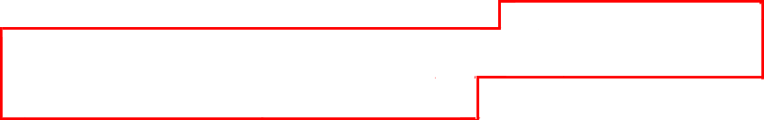
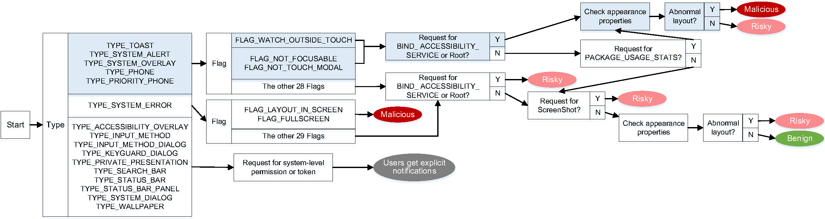
Robustness to knowledgeable attackers
It is possible for an attacker to bypass our detection with considerable efforts, but the adversaries’ difficulty in launching the attacks will be greatly increased
For example, the “cloak and dagger” attack, which is a famous overlay-based attack discovered by Yanick et al in Oakland’17
Notes:
We also try to analysis the robustness of our system, In the learned classification logic of OverlayChecker, it may not be difficult for a knowledgeable attacker to pick a single overlay feature used in our system and make it look (more) benign. However, OverlayChecker’s detection is to consider all features of an overlay in combination to determine its malice. What’s more, OverlayChecker is data driven and ML-based. It is possible for an attacker to bypass our detection with considerable efforts, but the adversaries’ difficulty in launching the attacks will be greatly increased. We also depicts a simplified flow chart demonstrating the branches of the model. And we analyze the most recent class of overlay-based attacks, “cloak and dagger” attacks, it can only go through a fixed path which is highlighted in blue in the figure above. It always results in a malicious or risky classification.

Slide 14
Conclusion & Dataset
First large-scale comparative study of overlay characteristics in benign and malicious apps. Our results reveal a set of suspicious overlay properties strongly correlated with the malice of apps, including several novel features.
A market-scale early detection system, OverlayChecker, to address overlay-based attacks in the Android ecosystem. It uses a machine learning model that incorporates static and dynamic app features.
Real deployment on a large-scale Android app store, analyzing 10K apps per day on a single commodity server. We also demonstrate its applicability to Google Play.
Dataset release: https://overlaychecker.github.io/
Notes:
In the end, let’s make a conclusion. In this paper, We conduct the first large-scale comparative study of overlay characteristics in benign and malicious apps using static and dynamic analyses. Our results reveal a set of suspicious overlay properties that are strongly correlated with the malice of apps, including several novel features.
We build a market-scale early detection system, OverlayChecker, to address overlay-based attacks in the Android ecosystem. It uses a machine learning model that incorporates static and dynamic app features. We developed custom emulation and dynamic execution infrastructure to increase its detection speed and resilience against stealthy malware.
And OverlayChecker is currently deployed on one of the world’s largest Android app stores, where it analyzes around 10K apps per day on a single commodity server. We also demonstrate OverlayChecker’s applicability to Google Play Store.
Finally, We release our dataset on github.
OK, that is it. Thanks for you attention.

